Slide 1
High-Frequency Trading Module 2: Technology and Regulation
Slides to accompany High-Frequency Trading: A Practical Guide to Algorithmic Strategies and Trading Systems, 2nd edition, by Irene Aldridge

Slide 2
Outline
Modern technology enabling HFT revolution
Regulation

Slide 3
1. A brief history of hardware
Cost
FPGA
and GPU
CPUx4
CPU
Calculator
Crank handle
Computational
speed
Sliding ruler
Abacus
2000
1900

Slide 4
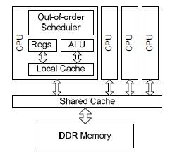
2. CPU
Key Characteristics
Architecture
“Central Processing Unit”
“Brain” of a computer
Decides how to store information in memory
Scalable through multi-core approach
CPUs use shared memory core-to-core cache coherency protocol for communication
Arithmetic Logic Unit (ALU) manages current thread
Other functions include management and scheduling tasks
Popular model: IntelCore2
Source: Thomas, Howes and Luk (2009)

Slide 5
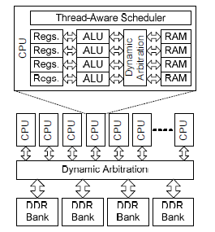
1. GPU
Key characteristics
GPU Architecture
“Graphics Processing Unit”
Most space on the chip is devoted to Arithmetic Logic Units (ALUs)
Threads are executed in parallel batches of 32
Batches are called “warps”
To minimize latency, all threads in the same warp should be similar in terms of:
# of loops
conditional exits
Popular model: Nvidia GTX 200
Source: Thomas, Howes and Luk (2009)

Slide 6
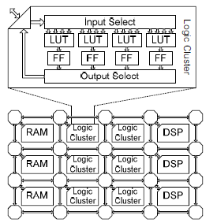
1. FPGA
Key Characteristics
Architecture
Do not have any fixed instruction-set architecture
Provide a fine-grain grid of bit-wise functional units
Can be composed to create any desired circuit or processor
Much of the FPGA area is dedicated to the routing infrastructure, which allows functional units to be connected together at run-time.
Modern FPGAs also contain a number of dedicated functional units, such as DSP blocks containing multipliers, and RAM blocks.
Popular model: Xilinx Virtex-5
Source: Thomas, Howes and Luk (2009)

Slide 7
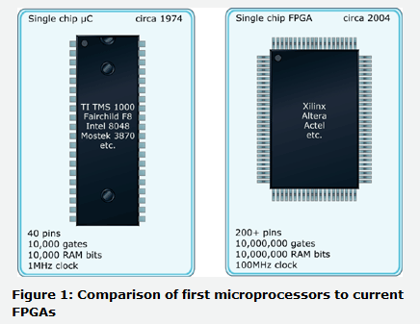
1. FPGAs – “souped up” microprocessors
Source: EETimes, March 3, 2004

Slide 8
1. FPGA
Key characteristics
CPU-FPGA Comparison (EETimes)
FPGAs are programmed using special programming languages Verilog or VHDL
Similar to C programming language -> easy to learn
FPGA programming device translates Verilog into Assembly understood by FPGA chips
The programs are written directly onto chips in Assembly
Eliminates delays in moving instructions from memory onto the processor (GPUs and CPUs access memory for instructions)
$4-$100 per blank FPGA chip
Free (open source)-$20,000 Verilog or VHDL “simulator”
Microprocessor | FPGA
Architectural design | Architectural design
Choice of language (C, JAVA) | Choice of language (Verilog, VHDL)
Editing programs | Editing programs
Compiling programs (.DLL, .OBJ) | Compiling programs
 | Synthesizing programs (.EDIF)
Linking programs (.EXE) | Placing and routing programs (.VO, .SDF, .TTF)
Loading programs to ROM | Loading programs to FPGA
Debugging P programs | Debugging FPGA programs
Documenting programs | Documenting programs
Delivering programs | Delivering programs

Slide 9
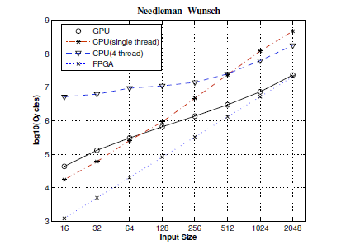

1. Accelerator speed depends on clock
Comparative speeds in cycles
How fast is one cycle?
Speed is determined by the “oscillator crystal”
shipped with CPU
Pentium 4 (2002) has clock rate of 3 billion cycles/second = ${10}^{9}$ cycles/second
Performance comparison:
Hardware | Data Size | Clock Cycles | Seconds
CPU | 128 | 10^6 | 0.001
CPUx4 | 128 | 10^7 | 0.01
GPU | 128 | 10^6 | 0.001
FPGA | 128 | 10^5 | 0.0001
Hardware | Data Size | Clock Cycles | Seconds
CPU | 2048 | 10^9 | 1
CPUx4 | 2048 | 10^8 | 0.1
GPU | 2048 | 10^7 | 0.01
FPGA | 2048 | 10^7 | 0.01

Slide 10
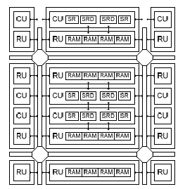
1. MPPA
Key characteristics
Architecture
Massively Parallel Processor Array
Newest type of architecture:
The CPUs are instantiated in a regular grid
2D communication channels between CPUs
Small local memories.
Such small CPUs provide excellent efficiency in terms of peak performance per mm2 or power efficiency
May present problems when partitioning applications
Popular model: Ambric AM2000
Source: Thomas, Howes and Luk (2009)

Slide 11
3. Core message architecture
Session start
Heartbeat
Quote message
Order message
Order cancellation
Order acknowledgement
Execution acknowledgement
Session end

Slide 12
3. Messaging Protocols in Trading
Key Characteristics
Graphic Representation
FIX/ITCH/OUCH are the “high-level” communication protocols
Financial Information eXchange protocol
ITCH and OUCH are NASDAQ’s alternatives
Requires messaging delivery protocol like TCP/IP
TCP/IP is a standard Internet communication protocol
Transmission Control Protocol/Internet Protocol
Used for e-mail, web browsing
All packets are numbered, the total number of bytes within the packet is counted, undelivered data is resent
UDP is a fast low-level protocol
User Datagram Protocol
Used for media streaming
Does not carry acknowledgements
Complexity
FIX/ITCH/OUCH
TCP/IP
UDP

Slide 13
3. Messaging protocols
Speed of protocols
Protocol security and usage
Transmission speed depends on:
Size of message
Connection bandwidth
TCP/IP and UDP window sizes (how many bytes the clients are willing to receive at once)
As a rule:
TCP/IP is 3 times slower than UDP
UDP: None
TCP/IP: some
Basic destination and packet count checks
FIX: optional encryption
Huge vulnerabilities persist
Trading venue
Protocol | Header size
UDP | 8 bytes
TCP/IP | 20 bytes
FIX | 100+ bytes
Quotes:
UDP + FIX
Trades:
TCP/IP + FIX
Trader

Slide 14
3. Messaging Architecture
Client-server model
Peer-to-peer model
Co-location model
Trader 1
Trader 2
Trader 1
Trader 1
R
R
Internet
Trader 2
R
Internet
R
Internet
Internet
Reliable ISP
node
Dedicated
network
R
Trader 2
Dedicated
network
R
Execution venue
R
Internet
Internet
R
Execution venue
Execution venue
Moderately secure, but slow
Faster, but security can be
Compromised by Trader 2
Fast and secure

Slide 15
3. Co-location
Key Characteristics
Savings from Colocation
Definition:
Trading servers housed in the same facility as execution servers
Trading servers often have dedicated network access
Alternatives
System warehousing in close proximity to the exchange
Benchmark costs:
$3000/rack of 20 servers
Time saving
Round-trip latency between New York and Chicago: 17-22 milliseconds
Savings can be high in volatile market conditions
Added security
Dedicated networks prevent packet snooping, message hacking
Unlimited savings from cyber attack prevention

Slide 16
Outline
Modern technology enabling HFT revolution
Regulation

Slide 17
2. Regulation
Like email, electronic trading cannot be wound back
Most regulators by now accept this view
No “ban algos” or “ban HFT” calls are considered in the U.S.
Quant community deems HFT “long accepted” as the dominant irreversible occurrence
However, prominent issues remain on the table:
Market manipulation
Inadvertent activity

Slide 18
2. Regulation of HFT
Detect Market Manipulation
Detect Inadvertent Activity
What is manipulative HFT?
How to measure the impact?
How to prevent another Knight Capital disaster?
Real-time surveillance
Exchanges see data in real time, are best positioned to monitor risk
At present, CFTC and FINRA receive tick data on a T+1 basis (the next day)
Cannot stop crises
Can detect recurrent market manipulation by analyzing account data
Difficulty analyzing cross-market trading activity (different clocks)

Slide 19
2. Regulation of HFT
Key Regulatory Issues
2.1 System stability
Detecting error-prone algorithms
2.2 Investor protection
Detecting intentional market manipulation
Front-running
2.3 Trade matching
Minimum quote life
Internalization of order flow
2.4 Market structure
Lit and dark pools
Swap Execution Facilities (SEFs)
2.5 Jurisdiction
Agencies
Countries

Slide 20
2.1 System stability
Definition
Best practices
Trading free of inadvertent algorithmic errors
Example of breach:
Knight Capital Group, August 2, 2012
Poor testing
Violation of best practices
Lack of oversight
HFT is software
Best practices for software development exist for years
ISO 9000
Cyclical implementation
Clearly defined scope
Modular implementation
Use-case testing
Oversight
Risk controls
Escalation procedures
…

Slide 21
2.1 System oversight
Present
Future
FINRA collects all tick data on a T+1 basis
Detects problems, sends descriptions over to the SEC
SEC prosecutes ~ 1 out of 8 FINRA complaints, according to FINRA
No trader identification (executing broker only)
CFTC collects all data per account on a T+1 basis
Unique Legal Entity Identifier (LEI):
Financial intermediaries
Banks
Finance companies
All listed companies
Hedge funds
Proprietary trading organizations
Pension funds
Mutual fnuds
Private equity funds
Other entities
Not for natural persons

Slide 22
2.1 System oversight
Where to survey the data?
Trader
Executing Broker
Exchange
- Most real-time data
- How to synchronize different exchanges?
At trader’s level:
Do not have market impact
At executing broker’s level:
Do not have market impact
Aggregating end-of-day settlement data is pointless
At exchange level:
Most timely data
Synchronize the clocks of different exchanges?

Slide 23
2.1 Exchange Surveillance
Implemented
Price banding, example
Circuit breakers (all exchanges)
A daily price change of at least x% halts trading
Price banding (CME and ISE)
Pause for 5-10 seconds if an intraday price band is breached
Protection points (CME)
A market order can only sweep through so many price levels
The unexecuted part of the market order automatically becomes a limit order
Cancel orders on system disconnect (CME)
“No cancel” range (ICE)
Reasonability limit
No cancel range (ICE)
Average price
Interval
price
Limit
(Hi/Lo)
Halt
Price drops below starting Interval Price
Limit within a given period

Slide 24
2.1 Exchange surveillance
Implemented (futures)
Near-term rollouts
Message throttle limits
Number of order cancellations to executions
Determined on a case-by-case basis in consultation with traders
Maximum quantity limits
Prevent fat finger errors
Real-time position validation
Credit checks
Price reasonability
Allow orders within Y% of market
Kill switches:
Automatically block/unblock order entry at the following levels
Execution firm
Account
Futures/options
Side of market
Product
Exchange
Allow cross-market risk-management
Other methods

Slide 25
2.2 Investor protection
HFT Market manipulation
Front-running
Market manipulation has to occur on a regular basis with demonstrated intent.
To detect market manipulating activity, regulators need to establish a pattern of market manipulation:
consider previous and subsequent market activity by the same entity
detect a sequence of actions along the same trajectory.
Observe client order flow, trade ahead of client
Feasible by broker-dealers
Legal under Dodd-Frank
Brokers no longer have to act in their clients’ best interest

Slide 26
2.3 Computerized matching rules
Present
Ideas
Automated markets follow Centralized Limit Order Book model
Aka double-sided continuous auctions
Same as human exchanges
Minimum Quote Life (MQL)
Implemented by EBS
250 ms quote validity for top-of-the-book quotes (best bid and best offer)
Changes in the matching algo impacted the markets
Internalization
Brokers should strive to match customer orders wherever possible
Blending of functions of brokers and exchanges

Slide 27
2.4 Dark and Light Markets
Light or open markets are traditional markets
Can observe the order book
Liquidity providers may reveal information through the order book
Some traders choose to consume liquidity only
Liquidity provision is not perfectly competitive
Liquidity providers earn rents in bid-ask spreads
Liquidity consumers may use that information to predict impending price moves
Liquidity providers, in turn, can predict the resulting order flow
Feedback loop due to Boulatov and George (2011)
Dark markets or dark pools
Cannot observe the order book
Advantageous for liquidity providers
Competition among liquidity providers further narrows spreads
However, due to informational advantages of dark markets, dealers earn more in dark markets than in light markets. See Boulatov and George (2011)

Slide 28
2.4 Dark or Light Markets?
Dealers have informational advantage in dark markets:
In dark markets, dealers can profit from their information by concealing their limit orders
By doing so, dealers earn superior returns
As a result, dealers prefer dark markets
However, dealers’ preference for dark markets reduces competition in light markets
Dealers trading in light markets can now charge higher rents in the form of the bid-ask spread
Ultimately, dark markets and light markets co-exist in equilibrium
When the rents dealers can charge in the light markets exceed their informational profit in the dark markets, dealers move to the light markets, and vice versa

Slide 29
2.4 Dark/Lit Equilibrium
To lit markets whenever:
- Too few market makers
- Rents are high
To dark pools whenever:
- Informational advantages are cost-effective
- Rents in lit markets are low

Slide 30
2.5 Market Regulation in the U.S.
Rules-based regime
Goal in equities: to achieve equal access through information: nationally compiled best bid and best offer (NBBO)
Regulation National Market Systems (Reg NMS) obliges all market places to distribute their best bid and offer prices for equities they are listing to a securities information processor (SIP)
Trades are to be executed at the best available price. Rule 611 Reg NMS bars marketplaces from executing their customers’ trades at prices worse than NBBO.
If NBBO is not feasible on a given exchange, the exchange has to route the order to another marketplace that can accommodate the order.
Alternatively, the order needs to be cancelled
NBBO is valid within 1 minute (can be “flickering”) – ouch!
Outcomes:
Lower spreads
Competitive bids
New exchanges

Slide 31
2.5 U.S. Regulation: Naked Access
The SEC banned the practice of naked or sponsored access, whereby
Market participants routed their orders under the broker/dealer id, but completely bypassing broker dealer’s risk checks.
Banning naked access arrangements has been met with widespread acceptance from the U.S. market participants.
An exception from the rule permits brokers to allocate risk management and supervisory processes to a sponsored customer if the customer is
(i) a registered broker-dealer and
(ii) if the customer can implement such processes more effectively

Slide 32
2.5 U.S. Regulation: Flash Orders
A flash order is an order type stemming from Reg NMS.
When a marketplace is unable to provide NBBO to an order, the order is flashed as the NBBO order in that marketplace.
If a participant in the marketplace is willing to match the order, he steps up to the plate.
Otherwise, the order is routed away in search of NBBO.
Flash orders effectively convert market orders to limit orders at the NBBO
Flashes are brief, and participants face steep technology requirements
Issues:
Fairness is in question
Possible effects on the markets:
Impair price discovery
Undermine consolidated tape
Disincentivise liquidity provision
Price improvement (Brodsky 2010)

Slide 33
2.5 U.S. Regulation: Colocation
In June 2010, the Commodity Futures Trading Commission (CFTC) proposed a rule to assure equal and fair access to co-location/proximity hosting services.
To ensure fair and open access for all traders, the regulator proposes
that marketplaces and third parties listing significant price discovery contracts (SPDCs) should implement uniform fees for colocation and associated services
CFTC designates which contracts are SPDCs based on:
The contract’s volume and liquidity
Potential for arbitrage with contracts traded on the designated contract markets
The use of the contract’s prices to settle other transactions
any kind of privileged pricing for specific market participants or classes of participants would not be regarded as equitable pricing
to increase the “latency transparency”, make the disclosure of latency information mandatory: markets would need to disclose their longest, shortest and average latencies
Generally regarded as a good idea, but implementation questions exist.

Slide 34
2.5 U.S. Regulation: Large Traders
The SEC proposed the implementation of a “large trader reporting system”
to “[…] identify large traders and collect trading data on their activity at a time when, for example, many such traders employ rapid algorithmic systems that quote and trade in huge volumes.”
Market participants would have to identify themselves as large traders if they meet at least one of the following criteria:
a) They trade at least two million shares or shares equivalent to $20 million during one day.
b) They trade at least twenty million shares or shares equivalent to $200 million during one month.
Large traders would receive a large trader identification number (LTID)
The respective broker-dealers will have to store all relevant data including the LTID based on the already existing Electronic Blue Sheet System.
Broker-dealers will have to provide this data to the regulator upon request on the morning following a transaction.
Broker-dealers will have to monitor whether their customers comply with this rule.

Slide 35
2.5 U.S. Regulation: Post Flash Crash
Circuit Breakers:
Automated circuit breakers for individual securities.
Halt trading in certain important securities as soon as their respective price changes by 10% or more within five minutes.
Circuit breakers are now nationwide
Halt trading in individually affected securities on all U.S. markets for a period of five minutes
Erroneous Trade Correction:
Clear rules as to when trades can be unwound
Stub Quotes:
Banned – market makers are now required to always quote within a pre-determined band of NBBO
Consolidated Audit Trail System:
New central database
“from receipt or origination, through the modification, cancellation, routing and execution of an order.”

Slide 36
2.5 Market Regulation in Europe
Principles-based regime
Goal: Best Execution
MiFID requires investment firms to: “[…] take all reasonable steps to obtain, when executing orders, the best possible result for their clients taking into account price, costs, speed, likelihood of execution and settlement, size, nature or any other consideration relevant to the execution of the order.” (European Commission 2004)
Outcome:
Greater competition
New players
Lower costs for all

Slide 37
2.5 Market Regulation in Europe
MiFID (European Commission, 2004)
“Markets in Financial Instruments Directive”
Harmonized regulation for investment services across 30 member states of the European Union, in addition to Iceland, Norway, and Liechtenstein.
Main objectives of MiFID:
Increase competition in investment services
Protect consumers in investment services
Main outcomes of MiFID to date:
Competition among trading venues has increased
Liquidity is scattered among different market venues
New venues challenged incumbents’ pricing, resulting in lower trading costs across the board

Slide 38
2.5 E.U. Regulation:
Important bodies:
Committee of European Securities Regulators (CESR)
European Securities and Markets Authority (ESMA) replaced CESR as of January 1, 2011
European Parliament
In response to HFT queries, CESR reported that
“The majority of respondents argued that HFT firms had played a role in supplying the markets with liquidity. This had helped to reduced bid-offer spreads and had reduced demand and supply imbalances, thereby helping to limit volatility.”
However, HFT risks were also raised:
increased bandwidth usage;
order entry/deletion and rogue algorithms;
increased market abuse with detection becoming more difficult in a fragmented and highly automated environment;
sudden liquidity withdrawal;
potential de-correlation of prices from market fundamentals if trading strategies focused solely on short term profits.
Key Outcome:
More studies are needed

Slide 39
2.5 E.U. Regulation: Swinburne Report
By the Committee on Economic and Monetary Affairs (E.U. Parliament)
Suggests implementation:
Robust infrastructure of all trading platforms (ability to cope with order barrage),
Demonstration of the ability of all trading platforms to re-create order books after unusual market activity,
ESMA supervision and definition by implementing acts of pan-European volatility interrupts and circuit breakers.
Urges more investigation into costs and benefits of HFTs
Urges classification as market abuses:
“Quote stuffing”
Flash orders
Naked access
Potentially, recommend mandatory periodic review of HFT algos

Slide 40
2.5 E.U. Regulation: Algo Trading
CESR seeks:
a broader definition of AT and the consideration of HFT as a subgroup of AT,
assuring that all persons involved in HFT over a minimum threshold would be authorized as investment firms;
proprietary HFTs who are persons dealing on own account will need to be authorizes as well (presently under Article 2.1(d) MiFID exemption)
requirements for authorized firms involved in automated trading relating to risk controls against trading system errors, notification of competent authorities concerning design, purpose and functioning of algorithms as well as risk controls for sponsored access
requirements for operators of trading venues concerning risk controls
risk mitigations by circuit breakers and stress tests
equal and fair access to co-location services (on a non-discriminatory basis).

Slide 41
2.5 E.U. Regulation: New Amendments
Proposals to require operators of regulated markets:
to ensure that a high frequency trader has to provide continuous liquidity (by quotation) similar to market makers if it executes significant numbers of trades in financial instruments on the market
to ensure that “orders would rest on an order book for a minimum period before being cancelled. Alternatively they would be required to ensure that the ratio of orders to transactions executed by any given participant would not exceed a specified level.”
The proposals only concern public markets
OTC and dark pools appear exempt, at least for now

Slide 42
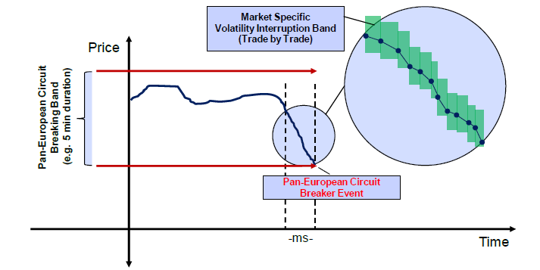
2.5 E.U. Regulation: Circuit Breakers

Slide 43
2.5 E.U. Regulation: Greek tax on HFT
Proposal ratified by the E.U. Parliament in March 2011
Non-binding
Gist:
To introduce Tobin transaction tax on all HFT activities
Under the proposal, the tax would be levied on each financial transaction by banks based in the European Union at a rate of up to 0.05pc
Estimated linear relationship between taxes and revenues: the analysis did not take into account shrinking volume
Was proposed by a Greek parliament member
Does not seem to gain traction

Slide 44
2.5 E.U. Regulation: Dark Pools
ESMA on dark equity markets:
the examination of existing pre-trade transparency waivers provided under MiFID and policy options regarding crossing systems and processes operated by investment firms.
In July 2010, EMSA recommended, among others:
the existing exceptions to pre-trade transparency continue to be allowed under certain circumstances
the European Commission undertake or commission further analytical work regarding the existing thresholds.
No action on dark pools

Slide 45
2.5 Canadian Regulation: Overview
Key Organizations:
Canadian Securities Administrators (CSA)
Investment Industry Regulatory Organization of Canada
Canadian regulators seek to conform with the international standards of financial regulation, specifically, the International Organization of Securities Commissions (IOSCO)
The Technical Committee of IOSCO covers algo trading, HFT and dark pools

Slide 46
2.5 Canadian Regulation: Dark Pools
Execution in dark pools will only be available on orders that meet or exceed a minimum size (the Dark Order Size Threshold);
the Dark Order Size Threshold for posting passive dark orders would apply
to all marketplaces, transparent or dark pools, regardless of the method of trade matching (including continuous auction, call or negotiation systems), and
to all orders whether they are client, non-client or principal.
Two dark orders meeting the Dark Order Size Threshold should be able to execute at the NBBO, and meaningful price improvement should be required in all other circumstances.
On a marketplace, visible orders should execute before dark orders at the same price, but two dark orders meeting the Dark Order Size Threshold can be executed at that price ahead of visible orders.
Meaningful price improvement should be one trading increment as defined in UMIR;
however, for securities with a difference between the best bid price and best ask price of one trading increment, one-half increment will be considered to be meaningful price improvement.

Slide 47
2.5 Australian Regulation: Overview
Key Organization:
Australian Securities and Investments Commission
Goal: market integrity
Recent developments:
new market integrity rules for competition in exchange markets
ASIC has introduced requirements with respect to pre-trade transparency, and has specifically introduced a framework which includes a minimum threshold for exemption from the pre-trade transparency requirements, initially set at zero.
This will enable ASIC to respond quickly if there is a shift of liquidity from the pre-trade transparent market in the short term at a level that would affect the price formation process.

Slide 48
2.5 U.K. Regulation: Overview
Latest Directions:
Economic research thus far provides no direct evidence that high frequency computer based trading has increased volatility.
Three main mechanisms that may lead to instability when financial markets involve significant proportions of Computer-Based Trading:
nonlinear sensitivities to change (where small changes can have very big effects),
incomplete information (where some agents in the market have more, or more accurate, knowledge than others),
internal “endogenous” risks based on feedback loops within the system.
The feedback loops can involve risk-management systems, and can be driven by changes in market volume or volatility, by market news, and by delays in distributing reference data.
normalisation of deviance, where unexpected and risky events come to be seen as ever more normal (e.g. extremely rapid crashes), until a disaster occurs.

Slide 49
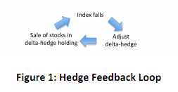
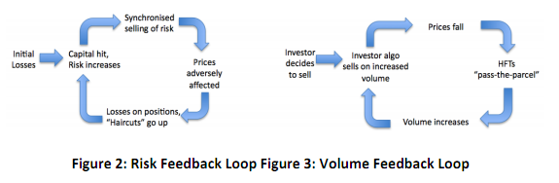
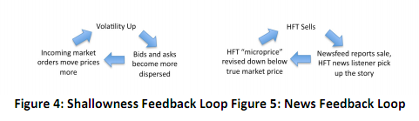
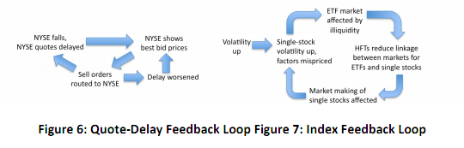
2.5 U.K. Regulation: Feedback Loops
Source: Government Office for Science, The Future of Computer Trading in Financial Markets, Working Paper

Slide 50
2. Regulation: some key points
Many HFT strategies thought to be adverse are not feasible on exchanges
Regulation and regulatory systems have been developed to monitor and address issues
Technology cannot be reversed

Slide 51
Outline
Modern technology enabling HFT revolution
Regulation

